Slide 1

Trend Identification on Stack Overflow
Team 30
Client: Christoph
Team members: Tianjiao (a1807401), Po-Yi (a1806297), Keerthika (a1784266), Vishnu (a1788534)

Slide 2
Outline
Project background
What is the project
Why is the project important
What is the solution and why is it feasible

Slide 3
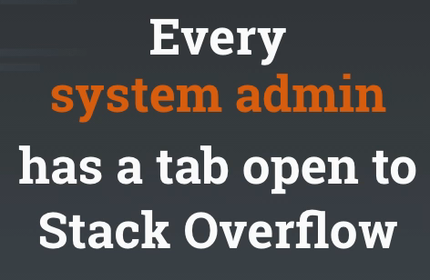
Project background
100+ million
monthly visitors to Stack Overflow & Stack Exchange
179% ROI
from companies using Stack Overflow for Teams
45.1+ billion
Times a developer got help since 2008
5,000+
Stack Overflow for Teams instances active every day
https://stackoverflow.com/

Slide 4



What is the project - Outline
Task: Extracting popular concepts on Stack Overflow
Tool: Natural Language Processing (NLP)
Result: Trend visualization for easy understanding

Slide 5
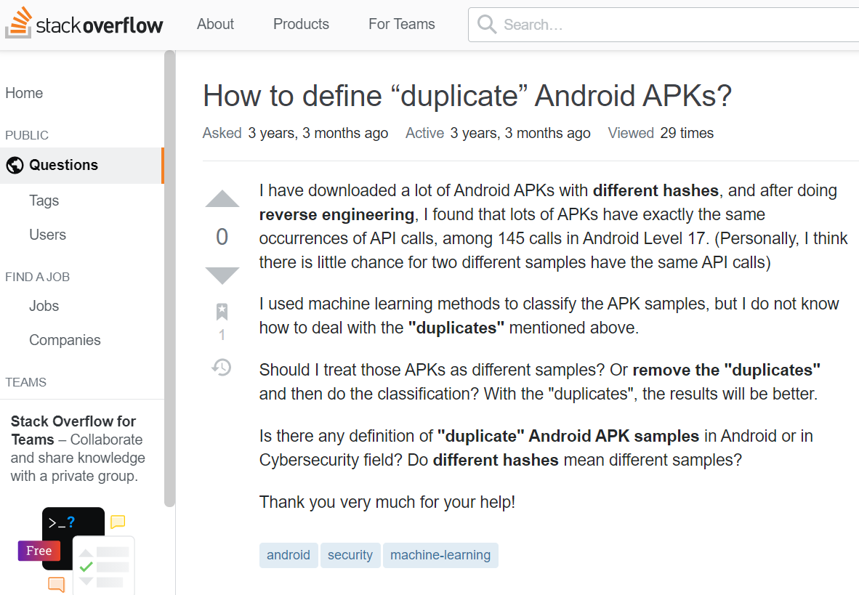
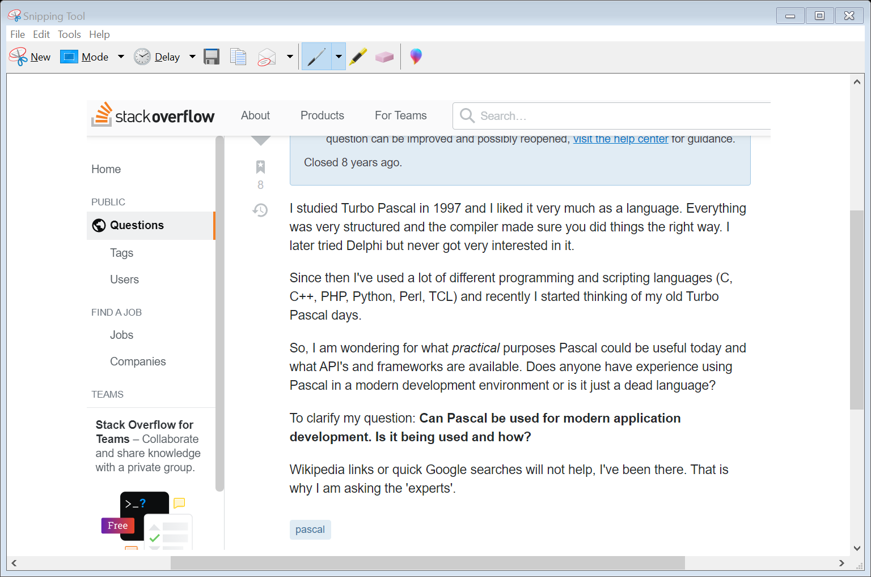
What is the project – extracting concepts
Which one is the hottest topic?
https://stackoverflow.com/questions/47704243/how-to-define-duplicate-android-apks
https://stackoverflow.com/questions/967473/pascal-and-its-current-applications

Slide 6

What is the project - NLP
Popular phrases aka. trends
Text from Stack Overflow
https://aliz.ai/natural-language-processing-a-short-introduction-to-get-you-started/

Slide 7

Noun phrase extraction in NLP
Noun Phrase : Part of speech patterns that include a noun. It may include multiple nouns.
Some of the patterns are:
Noun
Noun-Noun-..-Noun
Adjective(s)-Noun
Verb-(Adjectives-)Noun
Techniques:
Identify phrases from noun or verb.
Identify frequently occurring token sequence.
Combining both techniques gets the most. accurate method.

Slide 8
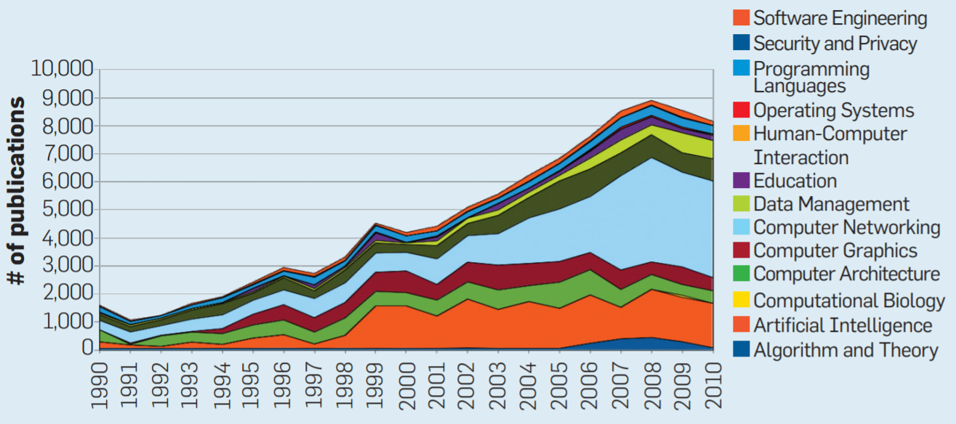
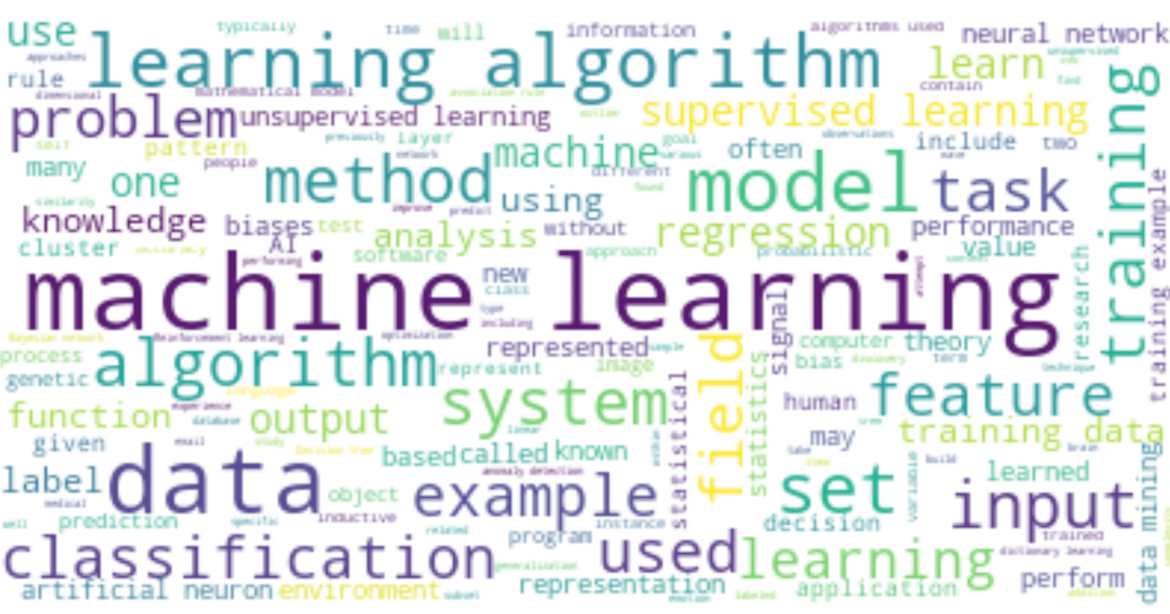
What is the project - visualization
Graph showing changes in trends over time
Visualization
Hoonlor, A., Szymanski, B. K., & Zaki, M. J. (2013)
List of popular concepts
https://programmerbackpack.com/word-cloud-python-tutorial-create-wordcloud-from-text/

Slide 9
What is the project - summary
Questions
Answers
NLP
Popular concepts

Slide 10



Why is the project important - Outline
For education – what to teach computer science students
For software companies – know what to invest in
Finding correlations – which programming language is suitable for a specific purpose

Slide 11
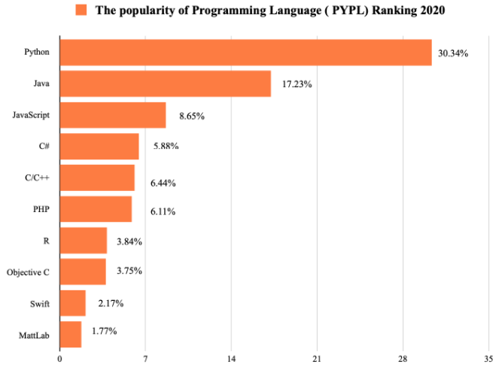

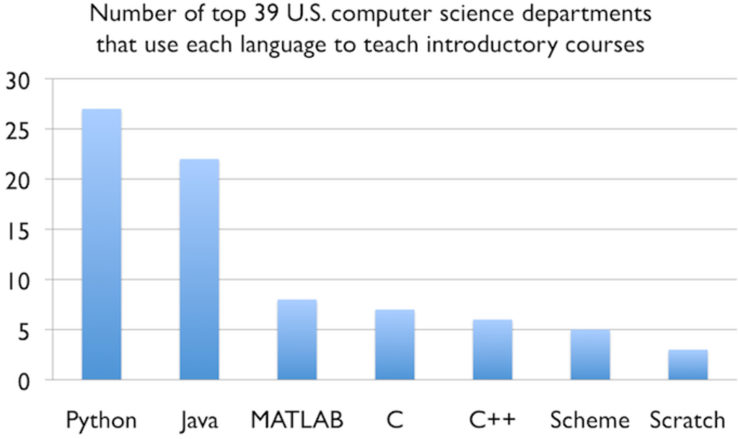
For Education
According to a survey of CS graduates, the content taught in CS courses are not aligned with employer requirements (Department for Business, Innovation & Skills, 2016)
https://darly.solutions/the-most-popular-programming-languages-in-2021/
https://cacm.acm.org/blogs/blog-cacm/176450-python-is-now-the-most-popular-introductory-teaching-language-at-top-u-s-universities/fulltext

Slide 12
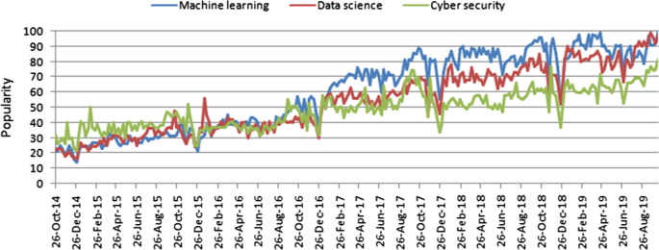
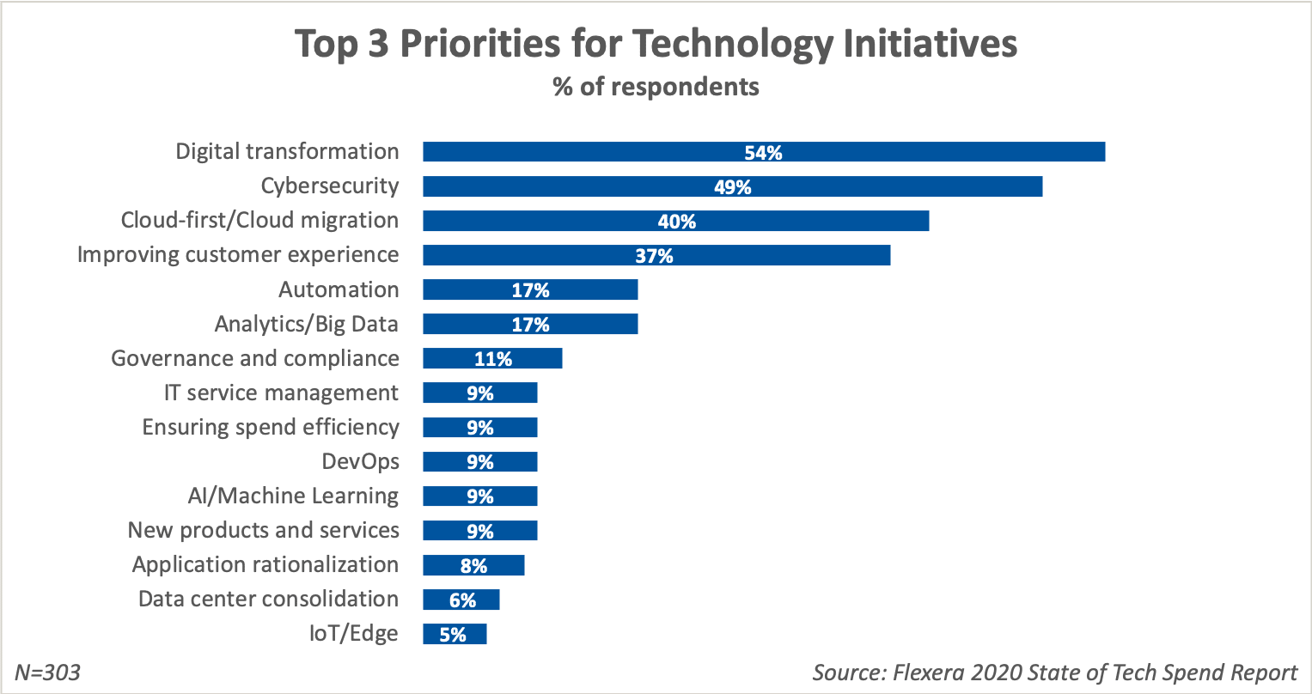
For Industry
https://journalofbigdata.springeropen.com/articles/10.1186/s40537-020-00318-5
Companies invest a lot on cybersecurity as it becomes a popular topic.
https://www.flexera.com/blog/industry-trends/it-spending-by-industry/

Slide 13
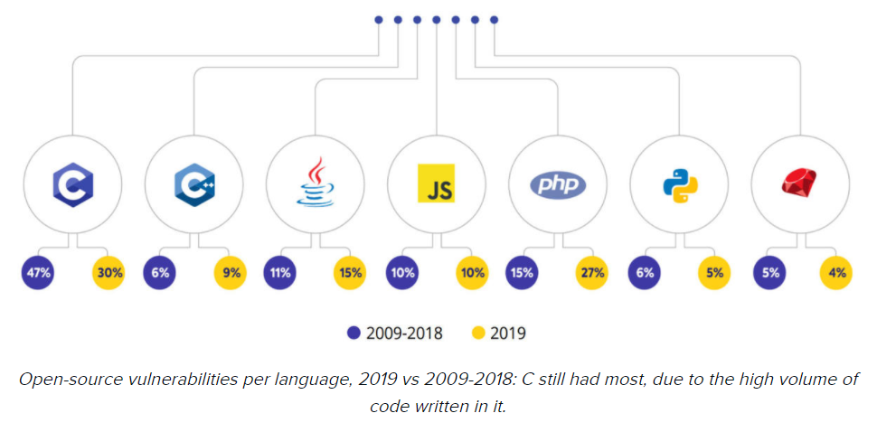
Finding Correlations
These languages are responsible for less open-source vulnerabilities
https://www.zdnet.com/article/open-source-security-this-is-why-bugs-in-open-source-software-have-hit-a-record-high/

Slide 14



Why is the project important - summary
For education
- Design courses to prepare students for employment
For business
– Invest on the fast-growing field
Finding correlations
– Apply the most suitable tool for a specific purpose

Slide 15
What is the solution and why is it feasible
 | Milestone 1 | Milestone 2
Activities | Extracting concepts from a subset (e.g., a specific time window) of stack overflow data List concepts by frequency | Visualize changes in trends over time using graphs
Outcome | A working software that takes a specific time window and output popular concepts within the time window sorted by frequency | In addition to milestone 1, the software should output graphs representing changes over time

Slide 16




Future scope
Allow users to customize pattern of phrases
Allow users to search for trends related to word of interest
Enable trend prediction
Analyze trends by programming language

Slide 17
Summary
What is the project – extracting popular concepts from Stack Overflow and visualize the trends
Why is the project important – latest trends are useful for education and business
What is the solution and why is it feasible – using NLP to analyze the text and deliver the product in 2 sprints

Slide 18
References
Department for Business, Innovation & Skills. (2016). Computer science graduate employability: qualitative interviews with graduates. London, UK: BIS Research Paper.
Hoonlor, A., Szymanski, B. K., & Zaki, M. J. (2013). Trends in computer science research. Communications of the ACM, 56(10), 74-83.

